Slide 1
Final presentation – Crime statistics
Heath THompson
Taylor Townsend
JIYIN Zhang
Scott martin
Dawson Hill

Slide 2
Goal and Mode of Collection
Data Driven Goal
The datasets were generated to find statistical data about crime in the greater Los Angeles area from 2020 to present date. Our collection was driven by the need to better understand crime rates for 2021 in LA.
data.lacity.org
Collection Type
The available data format for the dataset includes CSV, RDF, JSON, XML, and RSS. We chose to use CSV as it worked best for our group.
The metadata uses the PREMIS data model which consists of 4 interrelated entities: object, event, agent, and rights.

Slide 3
Analysis study for machine learning
Preliminary
Question 1 –
Which victim descent (race) is most likely to be victims of a crime in Los Angeles?
Question 2 –
Within the city of Los Angeles, at any particular time, is there an increase or decrease in crime rates, in comparison to the location where the crime took place?
Question 3 –
Is there a correlation between the age of victims and their associated gender?

Slide 4
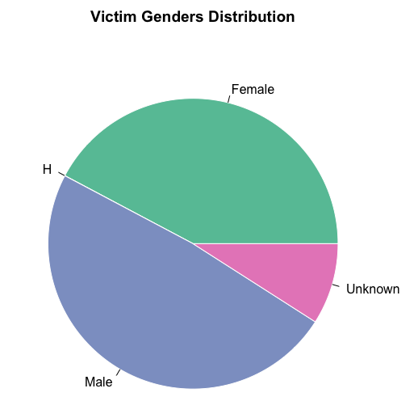
Preliminary Visualizations
MALE VERSUS FEMALE CRIME VICTIMS
Gender | Amount
F - Female | 75263
H | 28
M - Male | 86765
X - Unknown | 16107

Slide 5
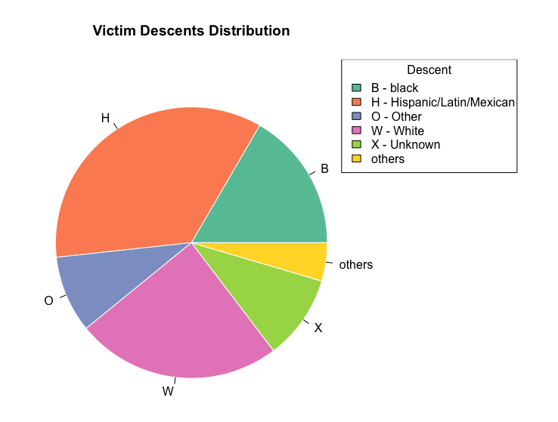
Preliminary VISUALIZATIONS
Race Distribution
Descent | Amount
B - Black | 29610
H – Hispanic/Latin/Mexican | 62546
O - Other | 16332
W - White | 43553
X - Unknown | 17970
others | 8150
Notes:
Need to compare this with age to answer Q2

Slide 6
Proposed outcome
Accurately Identify People who are most likely to become a victim of crime in LA
If there is a direction correlation considering location, time, age, race, and sex, then can we predict if certain individuals are most susceptible to being a victim of a crime in Los Angeles?
Analysis is based on the following categories –
Race
Age
Sex
Time of day
Location

Slide 7
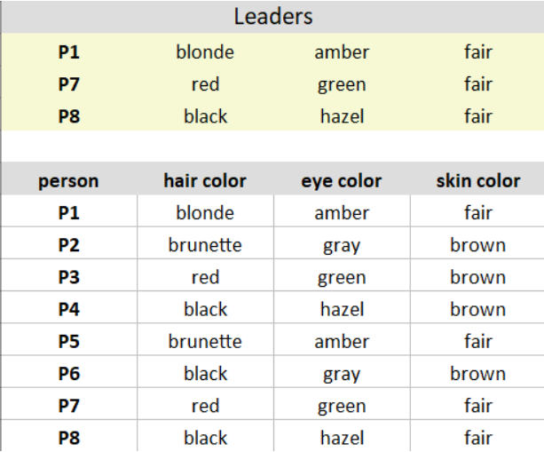
Machine learning - kmodes
Step 1: Assign K observations as the K clusters/leaders
Step 2: Calculate the dissimilarities and assign observation to most similar cluster
Step 3: Update the clusters features
Step 4: Repeat steps 2 and 3 until the clusters no longer change
https://www.analyticsvidhya.com/blog/2021/06/kmodes-clustering-algorithm-for-categorical-data/
Notes:
Provide a description of the choice of tools/ methods used or a description of any code or scripts written, and describe how your results were stored and managed

Slide 8
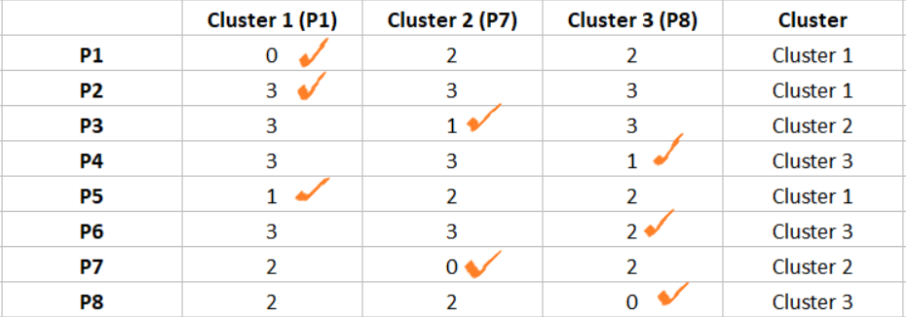
Machine learning - kmodes
Notes:
Provide a description of the choice of tools/ methods used or a description of any code or scripts written, and describe how your results were stored and managed

Slide 9
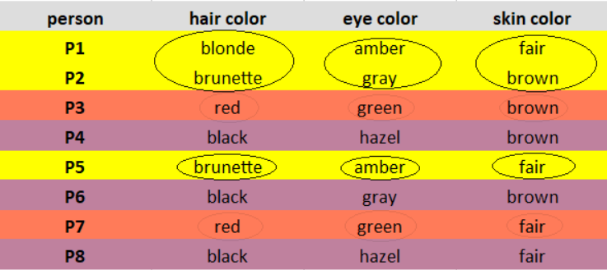
MACHINE LEARNING - KMODES

Slide 10
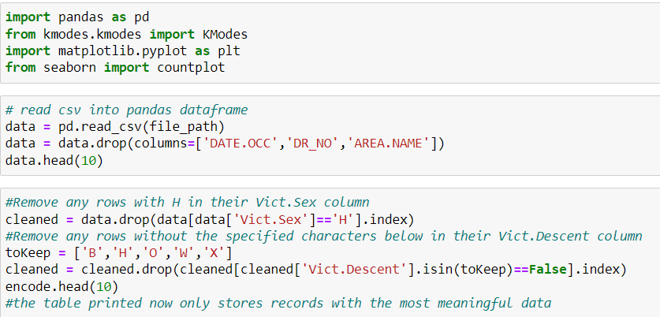
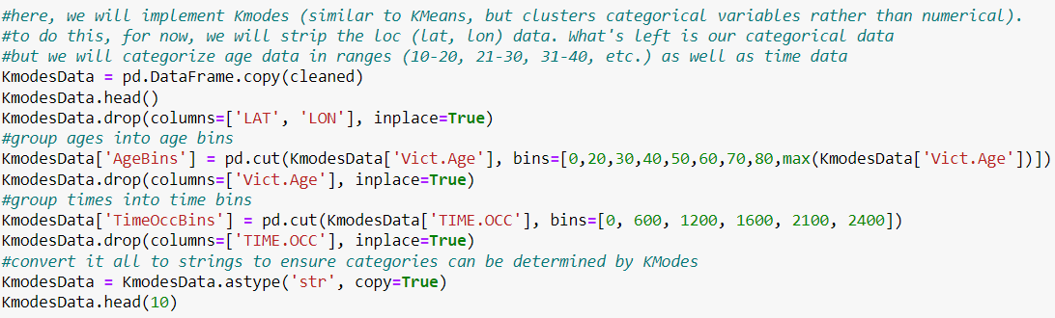
Full Analysis ML - Preprocessing

Slide 11
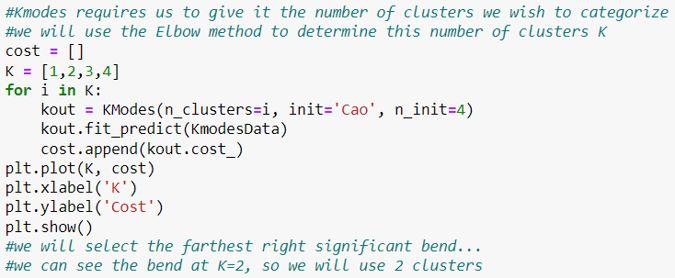
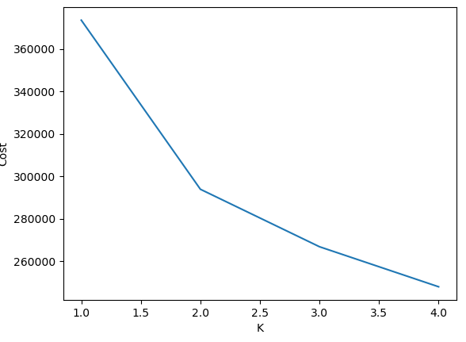
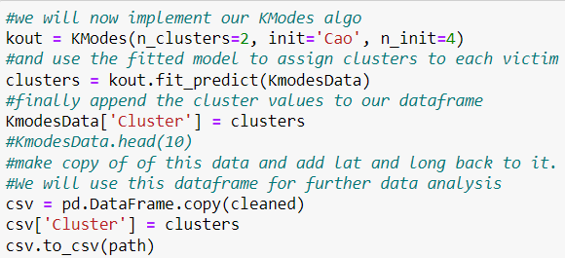
FULL ANALYSIS ML – Model

Slide 12
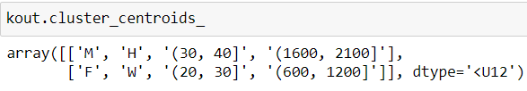
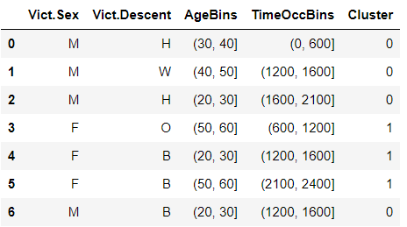
Machine learning – POST ANALYSIS
K-Modes Output:
- Initialized clusters:
- Each entry assigned a cluster
- Clusters update after each iteration

Slide 13
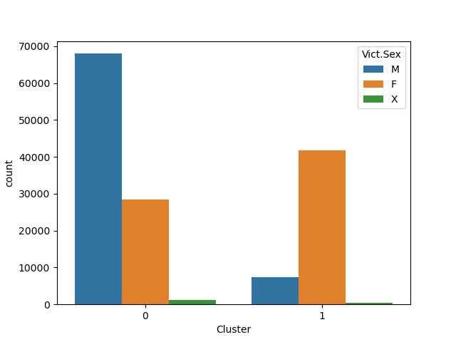
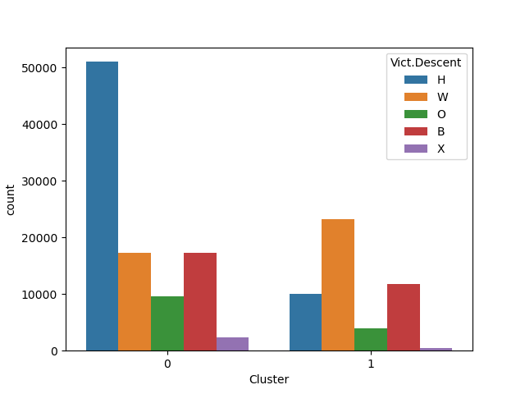
Machine learning – POST ANALYSIS

Slide 14
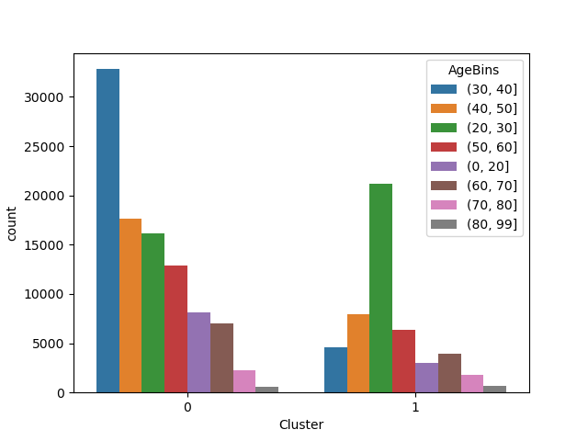
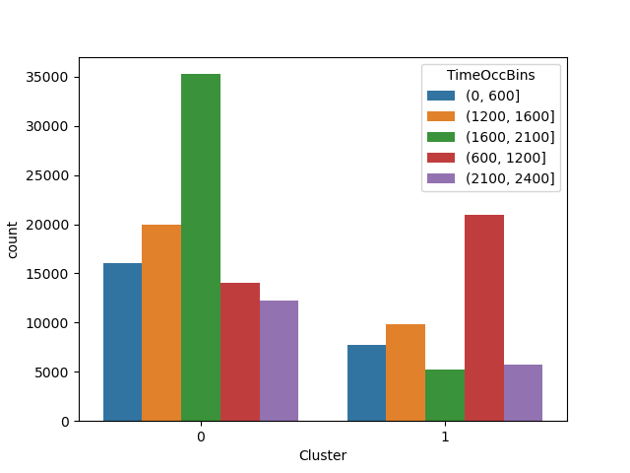
Machine learning - POST ANALYSIS

Slide 15
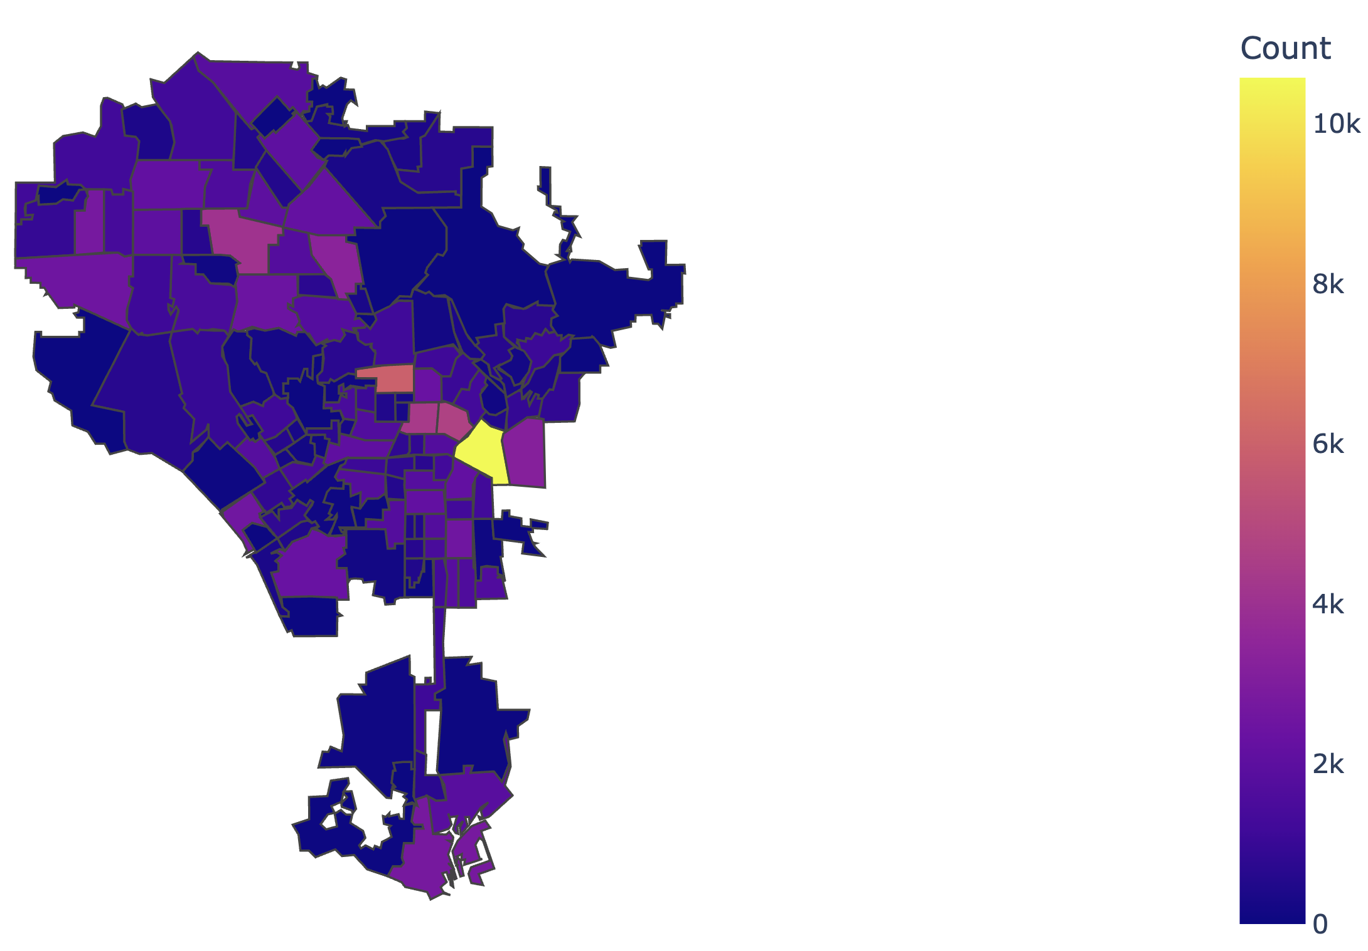
VISUALIZATIONS
CHOROPLETH MAP for Incidents
AreaName | Count
Downtown | 10577
Hollywood | 5948
Westlake | 4716
Koreatown | 4424
Van Nuys | 4126
North Hollywood | 3389
Boyle Heights | 3220
San Pedro | 2782
Canoga Park | 2760
Venice | 2611

Slide 16
Hypotheses questions – POST ANALYSIS
Question 1 –
Which victim descent (race) is most likely to be victims of a crime in Los Angeles?
Answer – Hispanic
Question 2 –
Within the city of Los Angeles, at any particular time, is there an increase or decrease in crime rates, in comparison to the location where the crime took place?
Answer – Downtown LA has greatest number of incidences between 4:00-9:00PM
Question 3 –
Is there a correlation between the age of victims and their associated gender?
Answer – Yes, we found that male victims tend to be roughly 10 years older than their female counterparts

Slide 17
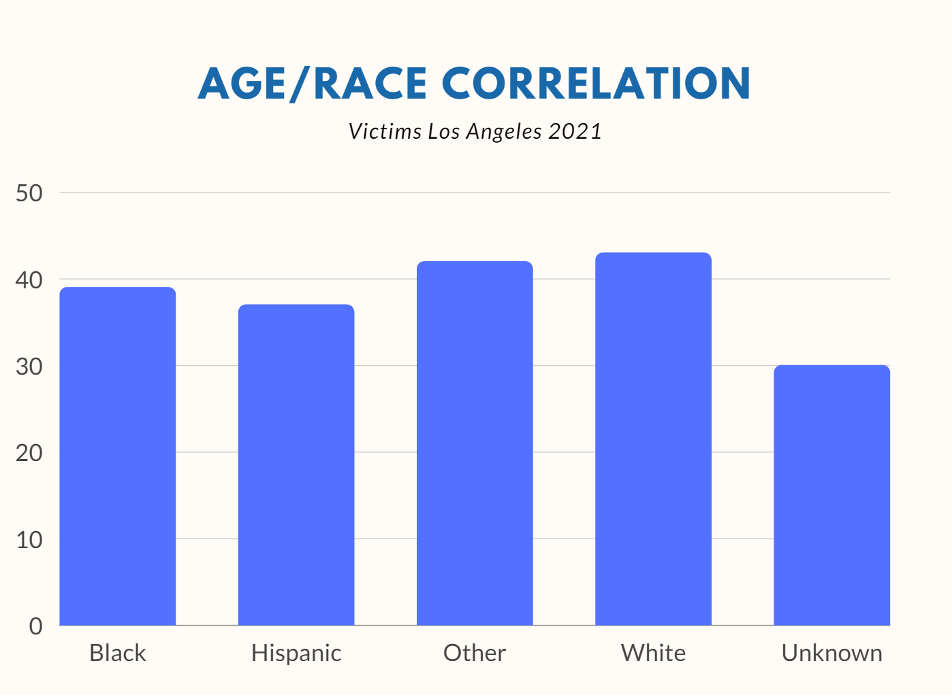
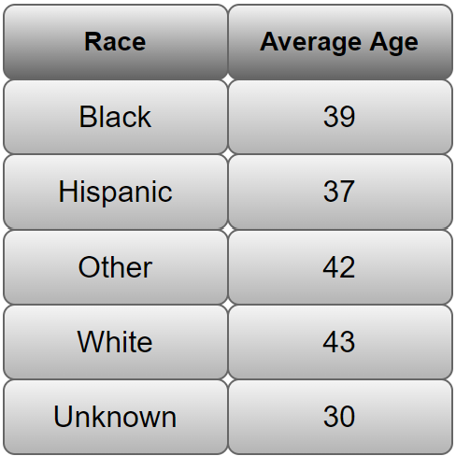
VALIDATION
Correlation of age and race
Average age of each descent group

Slide 18
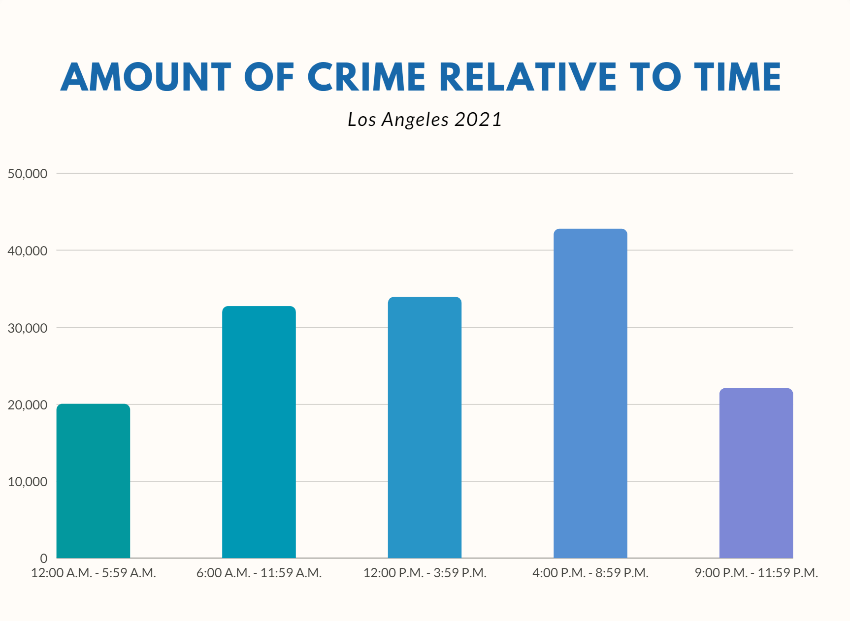
VALIDATION
Time and location
Occurrences of crime during different times of the day

Slide 19
Data management plan
Logical Collections – 1 file with 28 columns
Date.Rptd
DATE.OCC
Crm.Cd.1
Physical Data Handling
Dataset – CSV file
Metadata – no available file, only on webpage
Interoperability Support – available for download in multiple formats
CSV, RDF, JSON, XML, and RSS

Slide 20
Data management plan
Security – None; available for public download
Data Ownership – Los Angeles Police Department
Metadata – 4 interrelated entities: object, event, agent, rights

Slide 21
Data management plan
Persistence – updated weekly online
Discovery
Data.lacity.org
Category (LAPD)
Tags (lapd, crime, crime data, police, safe city, crimes)
Dissemination – publicly available online

Slide 22
Thank you! Questions?

